Slide 1



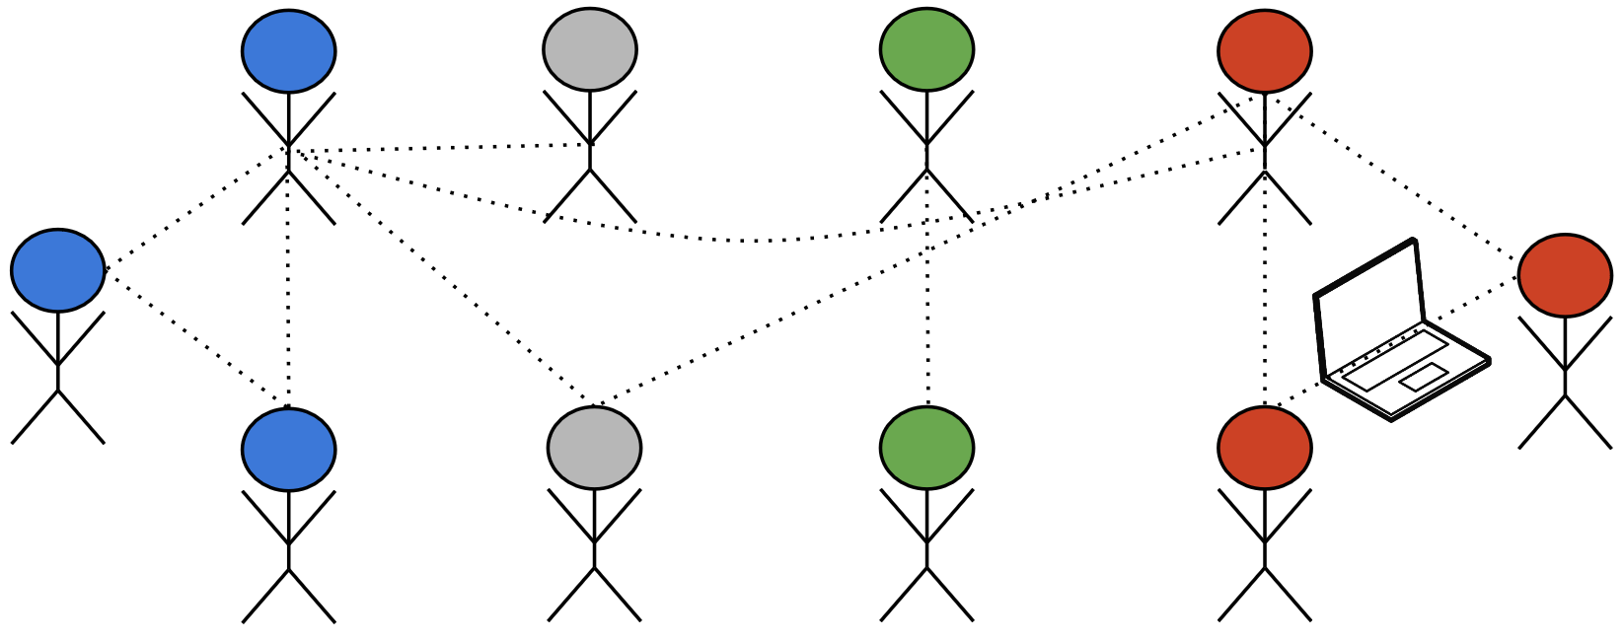
Child Welfare System: Interaction of Policy, Practice and Algorithms
Devansh Saxena¹ , Karla Badillo-Urquiola², Pamela Wisniewski², Shion Guha¹
Introduction
Family Services Coordinator
Child & Family Liaison
Licensing Specialist
Case Manager
This study is part of a larger work-in-progress project on developing human-centered algorithms to aid decision-making in CWS. It depicts our preliminary findings regarding the algorithms currently being used and how they impact CWS workers' decisions. In this study, we posed the following high-level research questions:
Family Preservation Program Manager
Case Manager Supervisor (Meeting Facilitator
Research Questions
What are the use cases of algorithms currently employed in practice?
What scenarios lead to a conflict between the algorithm and policy/practice?
How is the conflict between the algorithm and policy/practice resolved?
Family Preservation Supervisor
Child Welfare Nurse
Permanency Consultant
Program Director
Figure: This image depicts a child-welfare multidisciplinary team meeting
Assess a child’s level of need
Recommend a placement setting
Calculate foster parent rate
RQ3: Co-opting the system
Algorithm does not account for trauma and punishes foster parents for taking good care of children
RQ1: Algorithm use cases
RQ2: Policy overrides practice and algorithm
CWS workers co-opt the algorithm to receive higher rates for foster parents
Theory-driven practice conflicts with policy and policy overrides practice leading to CWS workers trying to co-opt the system
The corrupt data tells the story that children are getting worse in the child welfare system
Recommendations
Participatory Design – Work with stakeholders to understand their needs and develop algorithms that are theoretically-driven and offer higher utility Understanding context – CWS workers maintain detailed notes for every case and store them electronically. This unstructured text can be analyzed using natural language processing techniques to understand the context with respect to every case
Acknowledgements
This research is funded in part by the Facebook Computational Social Science Research Methodology Award, William T. Grant Foundation, and the Northwestern Mutual Data Science Institute.
¹Department of Computer Science, Marquette University ²Department of Computer Science, University of Central Florida

